Slide 1
FOSS / Linux News!
2024.11.06

Slide 2

Fedora 41 released!
Uses Gnome 47 -- Accent colors, new dialogue window style etc
New default terminal emulator -- Ptyxis “first class support for containers”
Support for installing Nvidia drivers with Secure Boot
IPU6 Camera support -- Intel IPU6 attached MIPI cameras
Notes:
https://fedoramagazine.org/whats-new-fedora-workstation-41/
https://www.phoronix.com/news/Fedora-41-Download

Slide 3


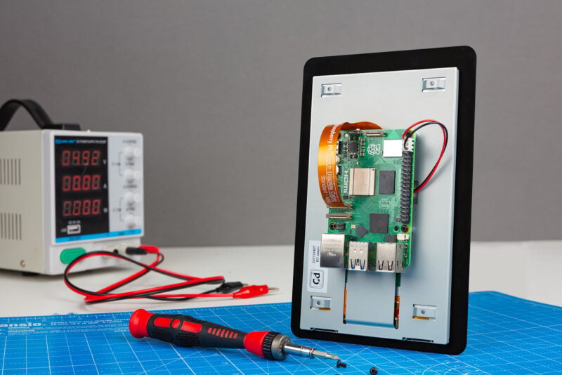
Raspberry Pi Touch Display 2
A new Raspberry Pi Touch Display - $60
7” 720x1280 LCD Panel
Multi-touch capacitive panel, supports 5-finger touch
Notes:
https://www.raspberrypi.com/news/raspberry-pi-touch-display-2-on-sale-now-at-60/
https://www.phoronix.com/news/Raspberry-Pi-Touch-Display-2

Slide 4

Coreboot drama
Coreboot is a software project aimed at replacing proprietary firmware
Malibal, a laptop vendor, published a blog post titled “Don’t Support the Coreboot Project” -- https://www.malibal.com/features/dont-support-the-coreboot-project/
Coreboot’s response -- https://blogs.coreboot.org/blog/2024/10/29/response-to-blog-post-from-malibal/
Notes:
https://www.malibal.com/features/dont-support-the-coreboot-project/
https://www.phoronix.com/news/Malibal-Suggests-No-Coreboot
https://www.phoronix.com/news/Coreboot-Rebuttal-MALIBAL

Slide 5

Removal of Russian Kernel driver maintainers
Patch to MAINTAINERS file, maintainers to some kernel drivers have been removed
Linus responds. “As to sending me a revert patch - please use whatever mush you call brains. I'm Finnish. Did you think I'd be *supporting* Russian aggression?”
tldr; sanctions and legal requirements
Notes:
https://www.phoronix.com/news/Russian-Linux-Maintainers-Drop
https://www.phoronix.com/news/Linus-Torvalds-Russian-Devs
https://lore.kernel.org/all/CAHk-=whNGNVnYHHSXUAsWds_MoZ-iEgRMQMxZZ0z-jY4uHT+Gg@mail.gmail.com/
https://www.phoronix.com/news/Linux-Compliance-Requirements
https://lore.kernel.org/lkml/2m53bmuzemamzc4jzk2bj7tli22ruaaqqe34a2shtdtqrd52hp@alifh66en3rj/
https://lore.kernel.org/lkml/e7d548a7fc835f9f3c9cb2e5ed97dfdfa164813f.camel@HansenPartnership.com/

